Slide 1

Introduction to Scrum
Understanding the fundamentals of Scrum

Slide 2
Agile methods
Agile methods
Scrum fundamentals
Scrum roles
Scrum events
Scrum artefacts
Conclusion
Principles of agility

Slide 3


Traditional lifecycle
Requirements
Design
Realization
Tests
Deployment
Analysis
Validation
TUNNEL EFFECT

Slide 4
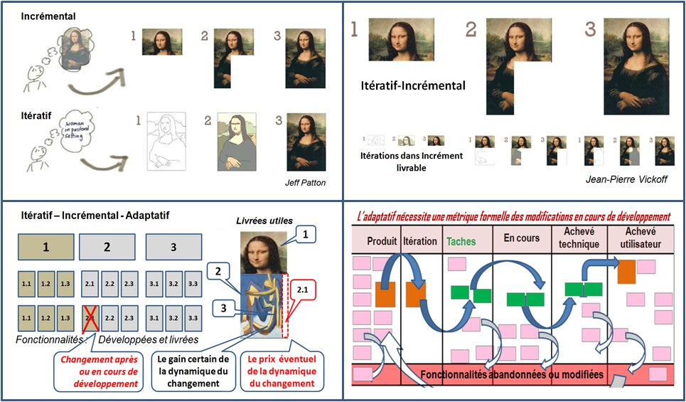
Iterative / Incremental process
Incremental
Iterative
Iterative / Incremental

Slide 5
The agile manifesto
Published in 2001 : http://agilemanifesto.org/
Based on existing methods (RAD, RUP, XP, DSDM…)
Iterative, incremental and adaptive methods
4 values
Individuals and interactions over processes and tools
Working software over comprehensive documentation
Customer collaboration over contract negotiation
Responding to change over following a plan

Slide 6
The agile manifesto : 12 principles
Customer satisfaction by early and continuous delivery of valuable software
Welcome changing requirements, even in late development
Working software is delivered frequently (weeks rather than months)
Close, daily cooperation between business people and developers
Projects are built around motivated individuals, who should be trusted
Face-to-face conversation is the best form of communication (co-location)

Slide 7
The agile manifesto : 12 principles
Working software is the primary measure of progress
Sustainable development, able to maintain a constant pace
Continuous attention to technical excellence and good design
Simplicity—the art of maximizing the amount of work not done—is essential
Best architectures, requirements, and designs emerge from self-organizing teams
Regularly, the team reflects on how to become more effective, and adjusts accordingly

Slide 8
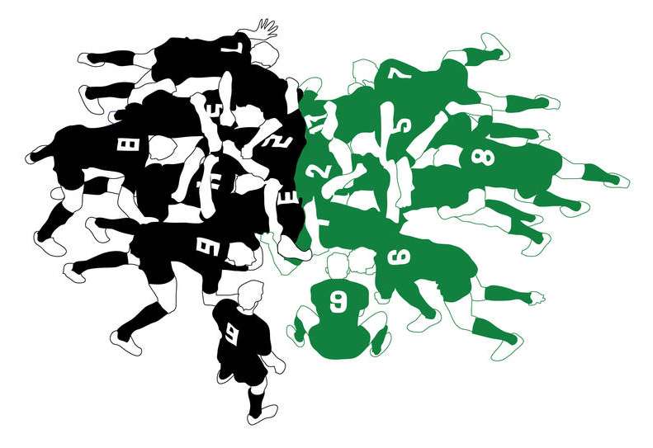
Scrum Fundamentals
Agile methods
Scrum fundamentals
Scrum roles
Scrum events
Scrum artefacts
Conclusion

Slide 9
Definition of Scrum
Scrum (n): A framework within which people can address complex adaptive problems, while productively and creatively delivering products of the highest possible value.
Scrum is:
Lightweight
Simple to understand
Difficult to master
(Scrum guide - Jeff Sutherland & Ken Schwaber)
Notes:
Predictable
Complicated
Complex
Chaos
Anarchy

Slide 10
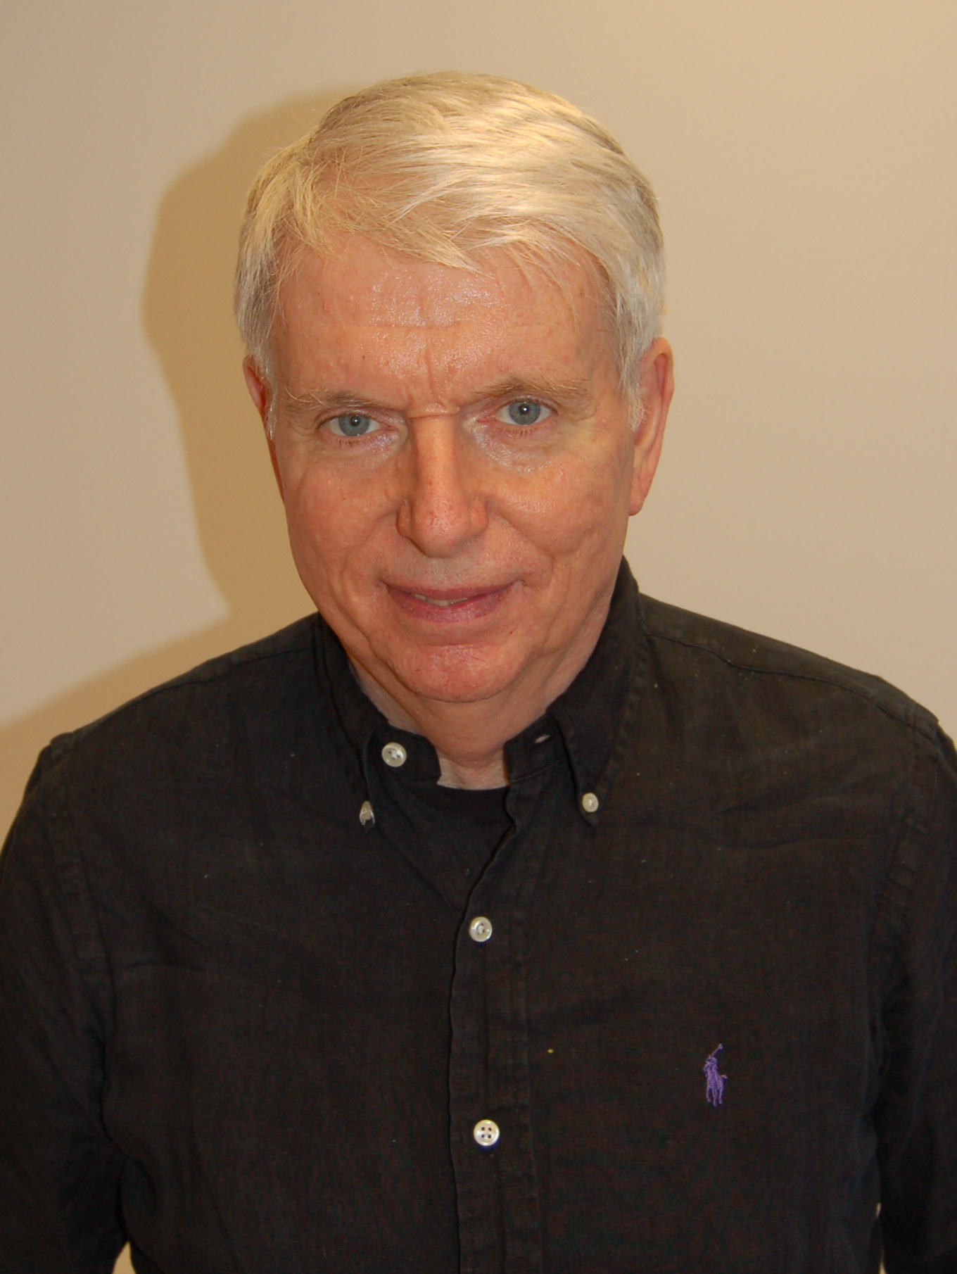



Scrum : The inventors
Jeff Sutherland
Ken Schwaber
Authors of The Scrum Guide
https://www.scrumguides.org

Slide 11
Scrum vs Traditional methods
When to use Scrum | When to use traditional methods
Scope is not clearly defined The product will gradually appear during the project | Scope is clearly defined upfront Clear product description is available upfront Similar projects were done before
Requirements change frequently Customer learns more about what they want as the project goes on | Requirements are well defined up front Few changes are expected during the project Requirements are not expected to change much
Activities cannot be well defined upfront Estimating (planning) is difficult | Activities can be well defined upfront Estimating is possible and reliable
Process is iterative (numerous cycles) Each cycle heavily depends on the previous one | Process is more long term Project might be split into phases
Success is mostly measured by customer satisfaction | Success is mostly measured by achieving the project goals for time, cost, scope…
Incremental results have value and can be used by users (put into production) | Users cannot normally start using the products until the project is complete

Slide 12


The Scrum timeline
Product Backlog
Sprint Backlog
Daily Scrum
Potentially Shippable Increment
Story
Story
task
Sprint review
Story
Story
task
task
Sprint retrospective
Sprint planning
Sprint (2-4 weeks)

Slide 13
Scrum elements
Product Owner
Scrum Master
Artefacts
Product Backlog
Dev team
Sprint Backlog
Product Increment
Roles
Definition of Done
Events
Release planning
Sprint planning
Daily Scrum
Sprint review
Sprint Retrospective
Product Backlog Grooming

Slide 14
Scrum pillars
3 pillars of empiricism :
Transparency
Inspection
Adaptation

Slide 16
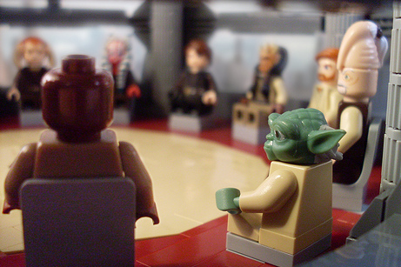
Scrum Roles
Agile methods
Scrum fundamentals
Scrum roles
Scrum events
Scrum artefacts
Conclusion

Slide 17




Scrum roles
Scrum team
Product Owner
Stakeholders
Development Team
Scrum Master

Slide 18
Scrum roles - Product owner
Business-oriented member of the performing organization, responsible for the Product Backlog
One person for the whole project
Responsibilities :
Maximize the return on investment
Ensure a shared vision of the project
Communicate with the customer & stakeholders
Define and priorize the product contents (Product Backlog)
Define a roadmap with the customer (Release plan)
Handle decisions on the project

Slide 19

Scrum roles – Product owner
Requirements
Communication
Customer

Slide 20

Scrum roles - Product owner
Required skills :
Sense of responsibility
Accurate knowledge of the business
Requirements definition techniques
Ability to negociate (CEO, Customers…)
Ability to make decision quickly
Ability to detail at the right time
Will to embrace change
Ability to delegate (Dev team)

Slide 21
Scrum roles – Scrum master
A scrum specialist, who manages the scrum process (not the team, aka the scrum master is NOT the project leader)
Helps the project actors to maximize the efficiency of scrum
Ensures the proper usage of scrum
Servant/coach of the dev team
Eliminates obstacles on the way, protects the team from outer stress/interferences
Induces the team to become autonomous
Might be a full-time role

Slide 22

Scrum roles – Scrum master
Required skills :
Deep knowledge of Scrum
Ability to understand the technical aspects
Good communication skills
Leadership
Mediation abilities
Tenacity
Inclination to transparency
To be eager to serve the team

Slide 23
Scrum roles – Development team
Applicative experts, responsible for the whole realization of the backlog stories
Cross-functional team
Self-organized
Common ownership of the scheduled tasks
Usually 3 to 9 members (preferably 7)
If more developpers needed, multiple teams mode : « Scrum of scrum »
Notes:
Pair programming

Slide 24
Scrum roles - Stakeholders
Anyone that is potentially affected by the outcome of the project
Customer
End users
Project sponsors
Sys admins
Management
Sales
Domain experts
…

Slide 25
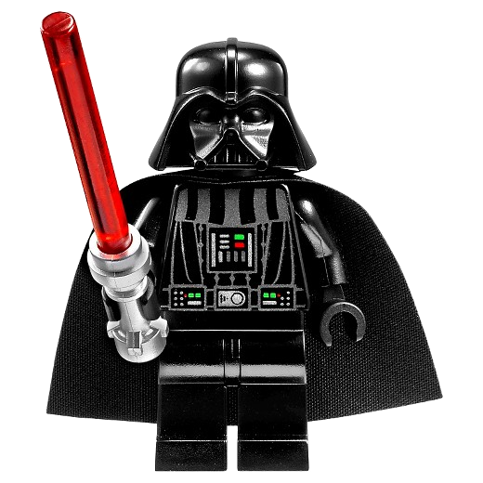
Scrum roles – Project manager ??
In Scrum, there is NO Project Manager role
Project management is distributed among the 3 main roles :
Product owner :
Business logic and customer interface
Priorities, release planning
Scrum master :
Organisation and human management
Dev team :
Tasks scheduling and affectation
Workload quantification

Slide 26
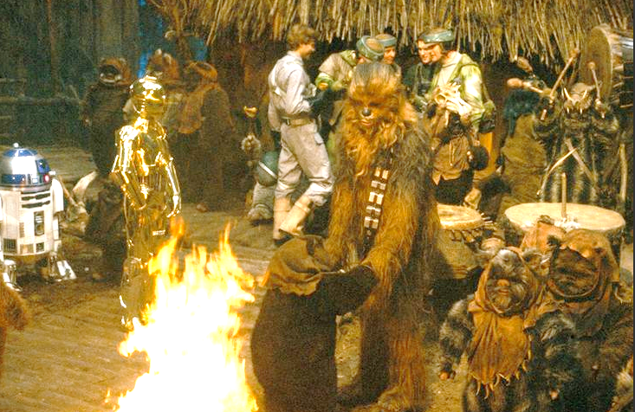
Scrum events
Agile methods
Scrum fundamentals
Scrum roles
Scrum events
Scrum artefacts
Conclusion

Slide 27

Timeboxing
Agile methods = ever changing environment
Fixed durations for each type of event
Goals are well defined
Strong constraint
Can be modified for next events upon return on experience

Slide 28
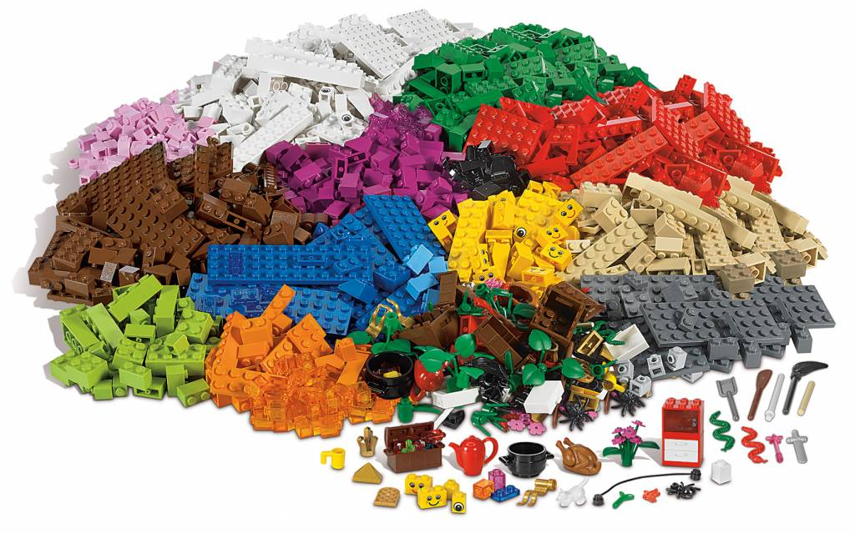
Before the first sprint
First version of the product backlog (PO / Customer)
Release planning (PO / Customer)
Creation of the Scrum team
Definition Of Done(Scrum team / Stakeholders)
Ensure the stakeholders understand and accept Scrum (PO / Scrum master)

Slide 29
Product backlog grooming
Punctual meeting (out of timeboxes)
Participants : Scrum team
Objective : update the product backlog
Estimate stories (Dev Team)
Re-order items (PO)
Add details (questions/answers)
Must consume less than 10% of the development time
Notes:
= backlog refinment meeting = backlog estimation = story time
Approx. 2h / 2 weeks
Higher priority backlog items
Detect and break epics >> item vs story
Independant
Negociable
Valuable
Estimable
Small
Testable

Slide 30
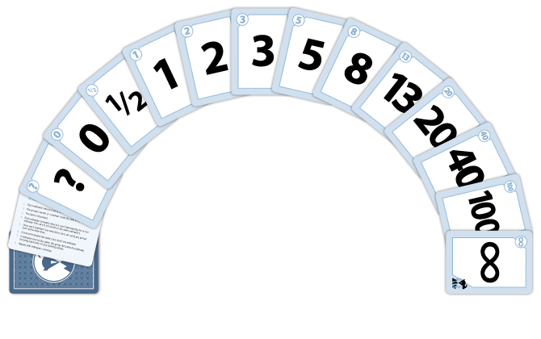
Planning poker
Estimation tool for a story
Unit : story point
Based on a standard (average-sized story)
Rules
Each developper has a full deck
Presentaion of the story (PO)
Each dev choses a value (hidden)
Everybody shows their choice
If differences, discussion
Play again until everybody has the same value
Notes:
Alternative : S - M - L - XXL

Slide 31
Scrum events – The Sprint
Sprint Planning
Daily Scrum
Daily Scrum
Sprint Review
Sprint Retrospective
SPRINT
Sprint = Development cycle
Leads to an increment
Timeboxing : 2-4 weeks - not to be changed during the project
Sprint contents does not change once started
Product Owner can decide to cancel a sprint

Slide 32
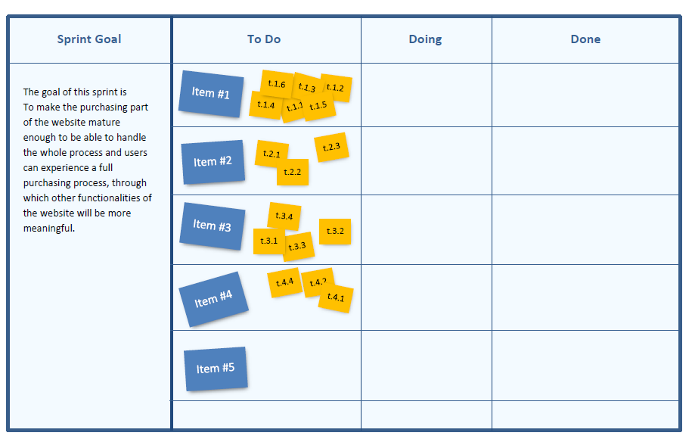
Scrum events – Sprint planning
Timeboxing : 5% of the sprint duration
Participants : Scrum team
Meeting
The PO presents the Sprint goals
The dev team estimates its capacity and selects the appropriate number of stories following the product backlog order
The dev team can ask precisions to the PO
The dev team details the stories into Tasks
The Sprint backlog is created (sprint board)
The Sprint is ready to start
Notes:
Average : only 60% of the effective tasks are known at this time, the rest will appear during the sprint (eg : unanticipated dependencies)
1 task <= 1 day of work (easier to detect a when a task is stuck)

Slide 33
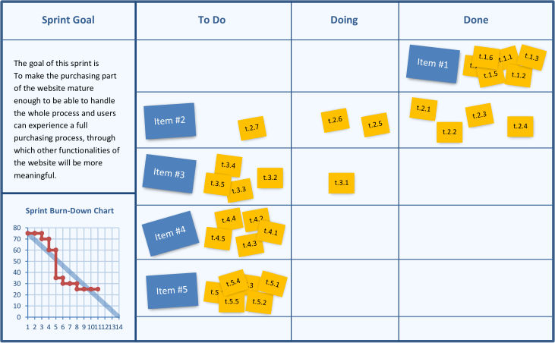
Scrum events – Daily scrum
Daily stand-up meeting (Dev team and Scrum master)
Self-organized
Timeboxing : 15 minutes
Each developer answers 3 questions :
What has been accomplished since the last meeting ?
What will be done before the next meeting ?
What obstacles are in the way ?
The sprint board can be updated
Notes:
The Product Owner can attend or not
Sidebar topics >> discussed after the meeting
Can make appear new tasks
Information radiators

Slide 34
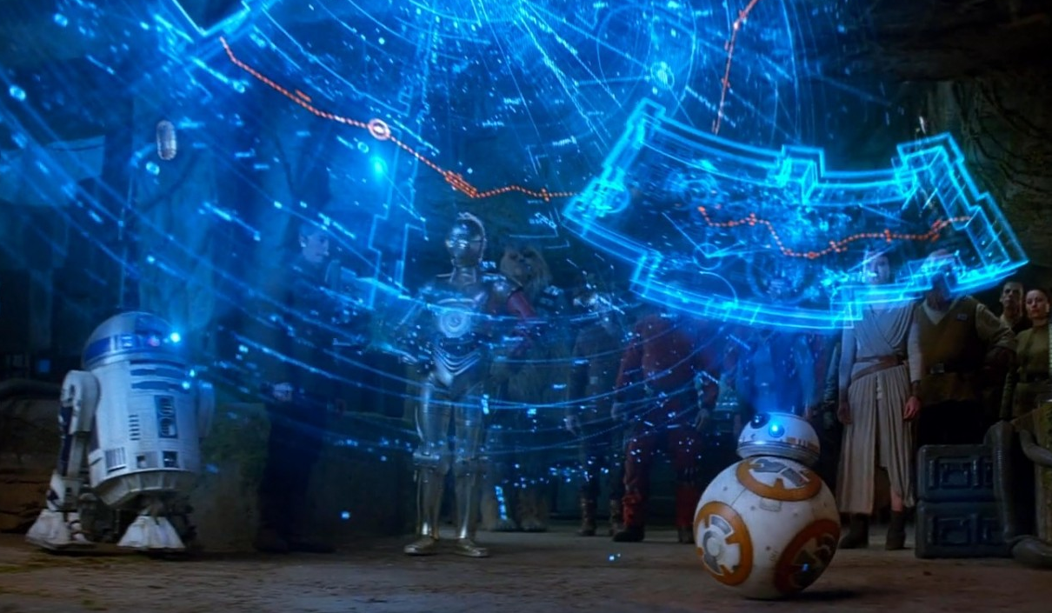
Scrum events – Sprint review
Meeting at the end of the sprint
Participants : Scrum team + Stakeholders
Timeboxing : 2 hours for a 2 weeks sprint
Steps
Reminder of the sprint goal - PO
Demonstration of the Done stories (only 100% done) – Dev team
Feedback collection : Change is welcome (customer satisfaction)
Product backlog update – PO (anyone can submit)
Dev team’s velocity calculation – Scrum team
Notes:
Inspect the product
Velocity : only to help the product owner to make forecasts

Slide 35
Scrum events – Sprint retrospective
Meeting after the Sprint review
Timeboxing : 1.5 hour for a 2 weeks sprint
Participants : Scrum team
Collective report in order to improve the methods
Steps
Information collection
Improvements proposition
Choice of a prefered improvement
Adaptation of the method for the next sprint
Notes:
Inspect the process
Safety check
What went well ? What went wrong ?
What did we learn ? What still puzzles us ?
Problem solving :
Objective questions (what happened ?)
Reflective questions (How do we feel about it ?)
Interpretive questions (What does it mean ?)
Decision questions (Whate are we gonna do about it ?)
Silent writing >> post its

Slide 36
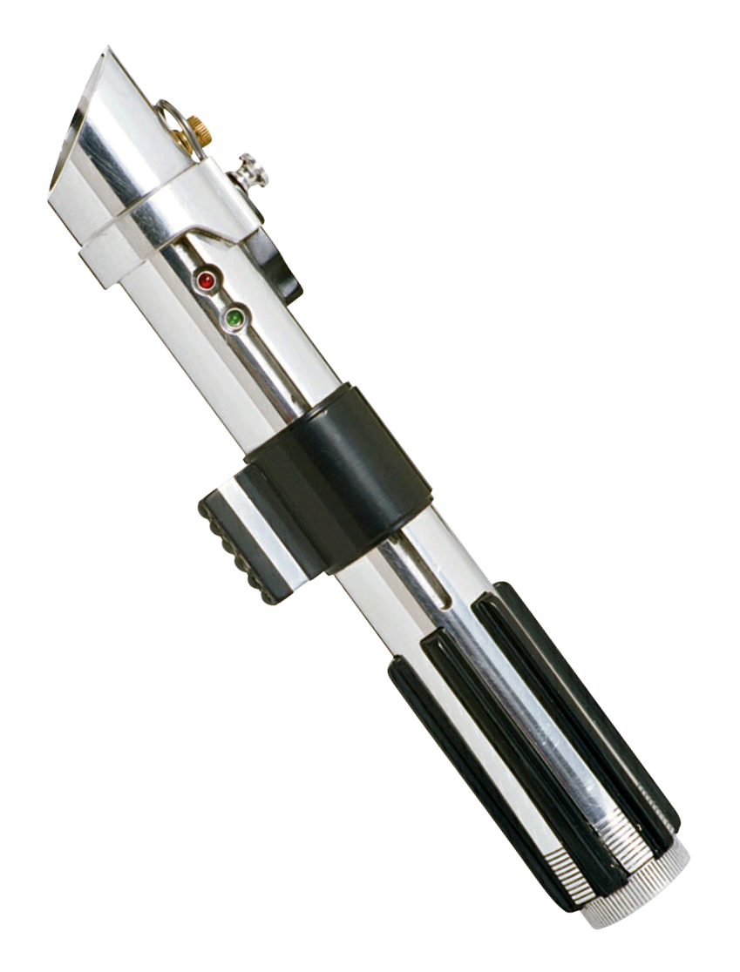
Scrum artefacts
Agile methods
Scrum fundamentals
Scrum roles
Scrum events
Scrum artefacts
Conclusion

Slide 37
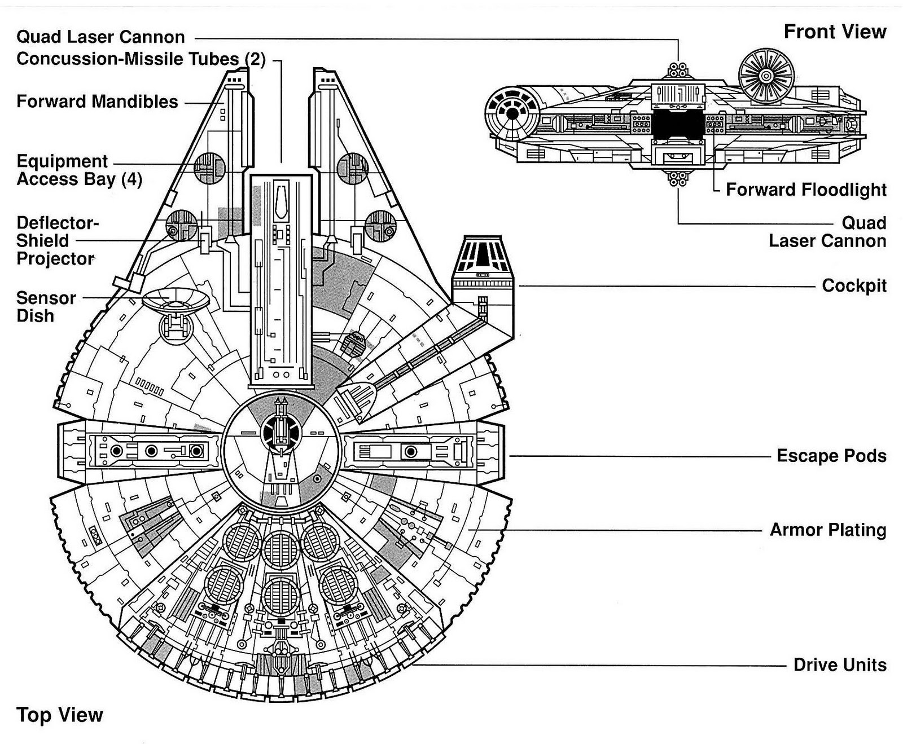
Scrum Artefacts – Product Backlog
Ordered list of everything that needs to be achieved to complete the project : Stories (functional, technical)
Sorted by priority, based on added value
Can be divided in releases (Release plan)
Always changing
Add / remove / modify stories
Change priorities
Must be shared and always up-to-date
Only one backlog for the project
Managed by the product owner

Slide 38
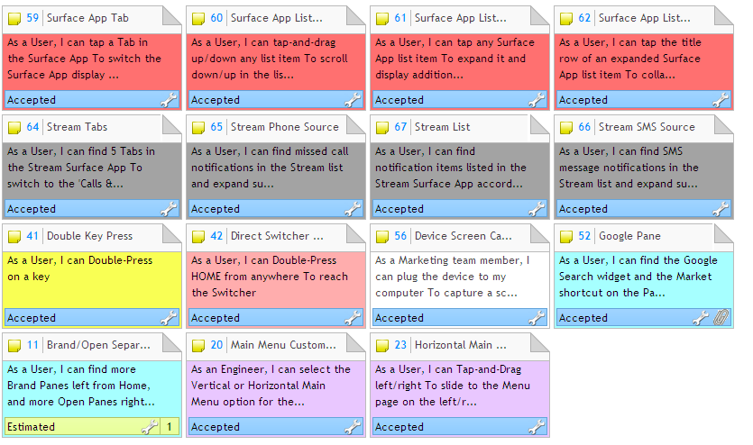
Scrum Artefacts – Product Backlog

Slide 39
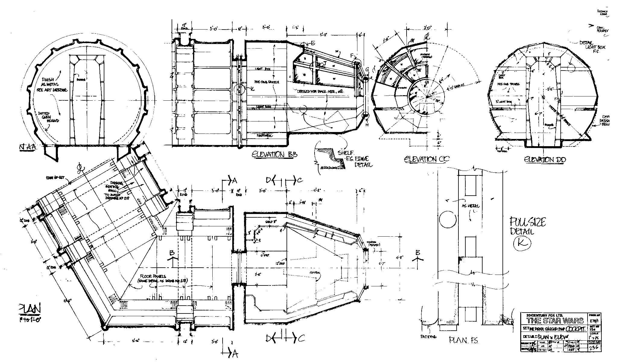
Scrum artefacts - Story
Story = Element to be produced
Name : expressed in simple, non technical business language
Category : User story / Technical story / Defect
Status :
Proposed
Accepted
Estimated
Planned
In progress
Done
Canceled

Slide 40
Scrum artefacts - Story
Description : every relevant information do describe the story (for the dev team)
Complexity : Estimation of complexity, expressed in terms of effort, or story points. Solely estimated by the dev team.
Tasks : detailed planning of the story, created by the dev team.
Feature : functional group to which the story belongs
Additional fields : due date, alerts, release, attachments, comments, assignment, estimated time…
A story must fit in one Sprint
Notes:
Who ? What ? Why ?
Acceptance criteria vs. Definition of Done

Slide 41
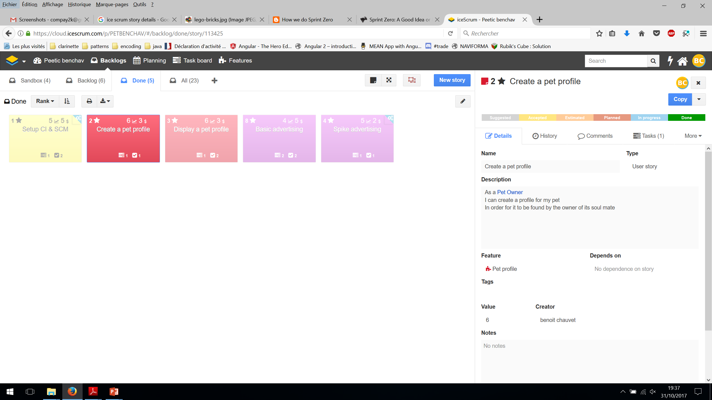
Scrum artefacts - Story

Slide 42
Scrum artefacts – Sprint Backlog
Stories to be achieved during the current sprint
Detailed tasks for each story
Sprint goal : summary of the sprint objectives
Cannot be changed once the sprint is started
Progress of the tasks
To do
In progress
Done
Burndown chart

Slide 43
Scrum artefacts – Sprint Backlog

Slide 44
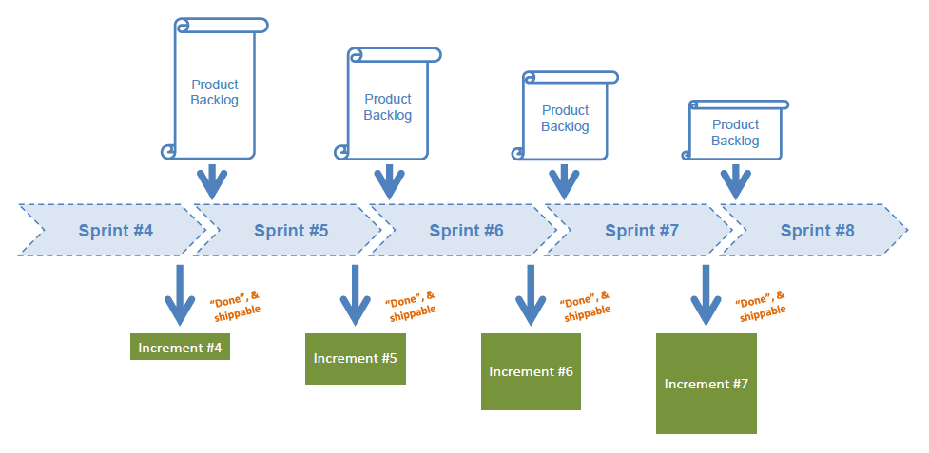
Scrum artefacts – Increment
Sum of all completed product backlog items at the end of a sprint
Must be done and shippable

Slide 45
Scrum artefacts – Definition of Done
Shared vision of acceptance criteria for an item to be considered as completed
Potentially releasable
Criteria :
Coded
Tested
Reviewed
Deployed / packaged
Can apply to a story, a task, an increment, a release…
Done = only 100% done
Notes:
Avoid technical debt >> refactoring
Importance of testing >> testing is a task
TDD & continuous integration

Slide 46
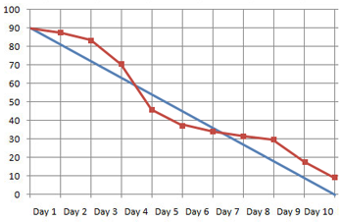


Scrum artefacts – Burdown Chart
Story points
Graphical indicator of progress
Expressed in story points done vs. Time
Applies to
Sprint (time unit = day)
Product (time unit = sprint)
Behind Schedule
Ahead of Schedule
Ideal progression
Actual progression
Time

Slide 48
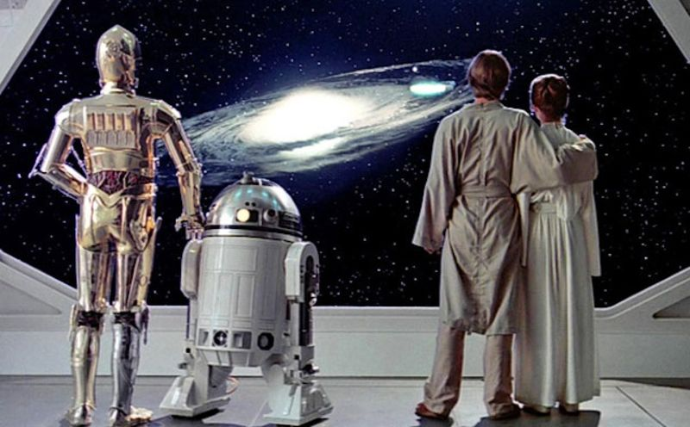
Conclusion
Agile methods
Scrum fundamentals
Scrum roles
Scrum events
Scrum artefacts
Conclusion

Slide 49
Facts and fiction
Fiction | Fact
Developers are free to do what they want. | Developers work in a productive and predefined framework and the Scrum Master makes sure they are following Scrum.
Scrum gets rid of all paper work and allows the team to start developing right away. | There are certain planning steps involved in every Scrum project and development can only start when the Sprint Backlog has been defined.
All requirements (in the form of stories) must be agreed before the Development Team is allowed to start working on the product. | The Development Team can start working as soon as the initial stories of the Product Backlog are read
Scrum is very easy to implement, even without training. | Using Scrum is a big change; It might seem easy to implement Scrum compared to other project approaches, but people must still have a good understanding of Scrum to be able to run their projects well.

Slide 50
Facts and fiction
Fiction | Fact
Scrum is just a set of simple rules. | Scrum is a set of rules and a framework, plus a compatible work culture and ethic.
The Scrum Master is like a project manager. | There is no one similar to a traditional project manager in a Scrum project. The Scrum Master makes sure the Scrum framework is followed.
Scrum does not require you to have a Business Case. | There should be a justified reason to spend any money in any company and this should be documented. The Product Owner is responsible for ensuring that there is a feasible reason for performing the project and aligning the project with it.
Scrum allows the Development Team to decide what will be delivered. | A Team only decides on how to deliver; it is up to the Product Owner to determine what will be delivered.

Slide 51
Facts and fiction
Fiction | Fact
The Product Owner is the project manager. | The Product Owner only creates and maintains the Product Backlog, but does not manage the day to day activities of the Team.
Scrum tells us everything about managing projects. | Scrum mostly deals with the definition and delivery of the products. Many of the business oriented aspects of the project are done outside Scrum.
The Product Owner is a representative from the customer. | The Product Owner is one of the people from the performing organization (the organization in charge of producing the final product of the project; a contractor in many cases), and the contact point with the customer.

